Slide 1

JavaScript Fundamentals
Course Introduction
SoftUni Team
Technical Trainers
Software University
https://softuni.bg/

Slide 2
Table of Contents
Introduction
Course Objectives
Trainers and Team
Course Details

Slide 3
Have a Question?
sli.do
#fund-js

Slide 4














SoftUni Diamond Partners

Slide 5

Educational Partners

Slide 6
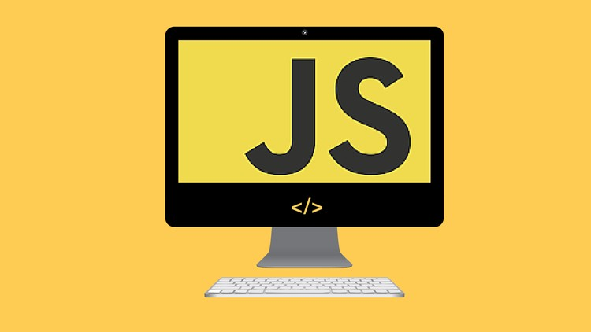
JS Fundamentals
Course Objectives

Slide 7
Course Objectives
Extends the Programming Basics course
Fundamentals coding skills for the JS language
Use of more complex techniques and structures such as arrays, classes, and objects
Ability to solve algorithmic problems
Introduction to the basics of web development

Slide 8
JS Fundamentals – Course Topics
Basic Syntax, Conditional Statements And Loops
Data Types and Variables
Arrays
Functions
Arrays Advanced
Objects and Classes
Associative Arrays
Text Processing
Regular Expressions

Slide 9

Trainers and Team

Slide 10
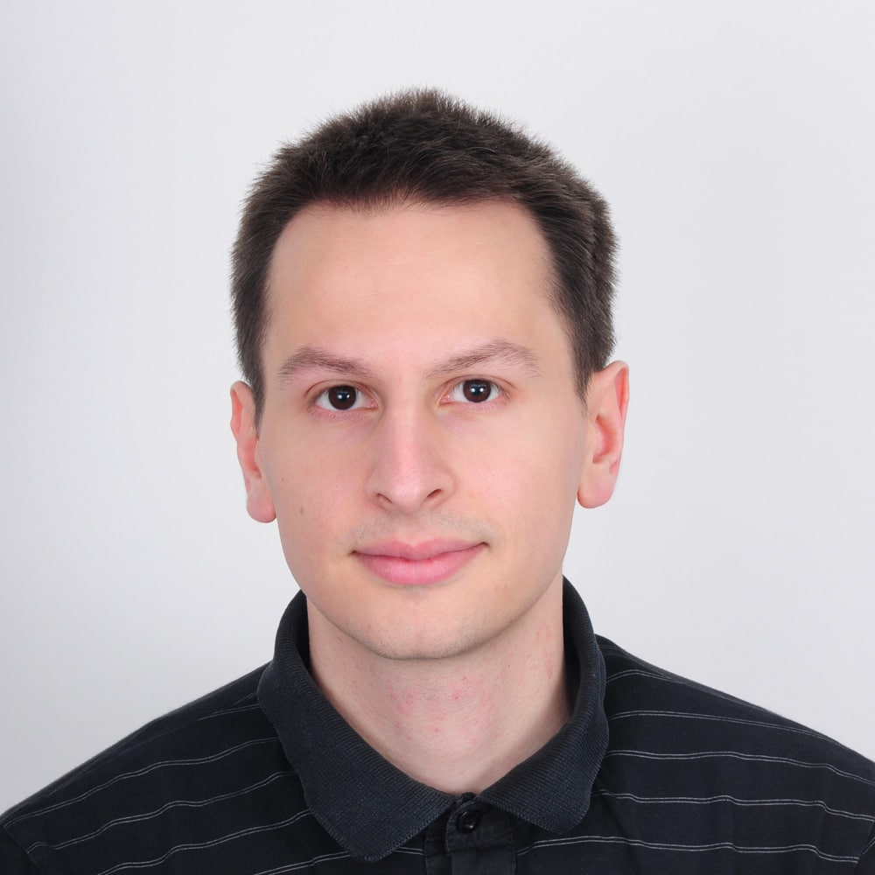
Viktor Kazakov
Worked on scalable high traffic distributed systems
Experience in JS, TS, Node.js, Angular, C#, ASP.NET MVC, Azure Cloud
Former Trainer @Software University
Former Full-stack Developer @Software University
Former Full-stack Developer @Developsoft

Slide 11
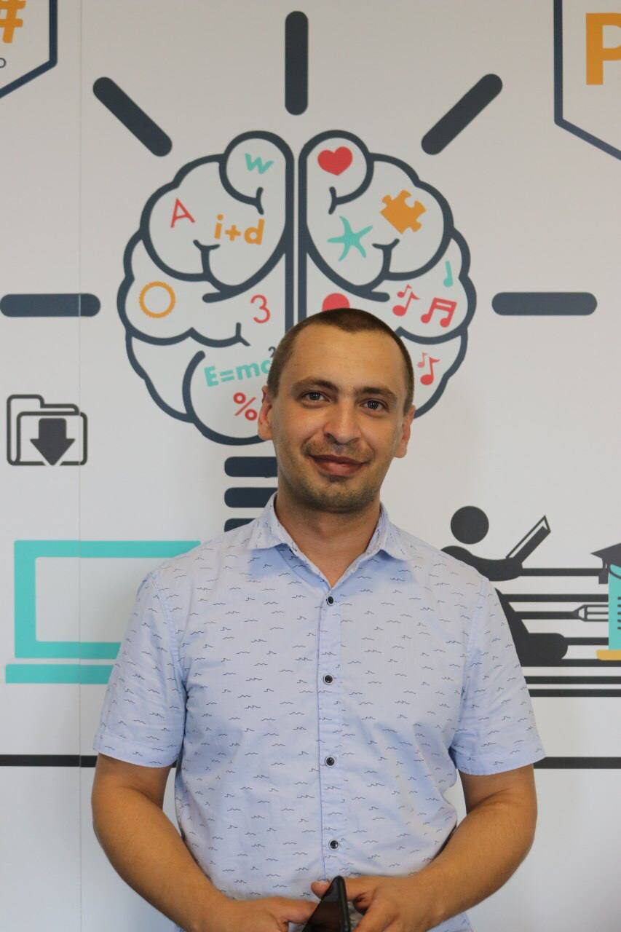
Todor Stoyanov
Front End Developer at SAP
4+ years of experience as a Technical Trainer at Software University
Experience JS, React.js, Angular, and Java

Slide 12

Course Details
Schedule

Slide 13

Practical Programming Exam
Mid Exam
3 practical problems for 4 hours
Conditional Statements and Loops
Linear Data Structures – Arrays
Final Exam
3 practical problems for 4 hours
Associative Arrays
Strings and Text Processing
Regular Expressions
Link to Exams

Slide 14
Theoretical Exam
20 questions for 30 minutes
Multiple choice
English
Automated quiz system
Available online – open when the practical exam starts and active 30 minutes after its end
You can submit your answers just one time

Slide 15
JS Fundamentals Module Timeline
JS Fundamentals
12 weeks
3 times per week
12 credits
Start: 09. Jan 2023
Mid-Exam: 19. Feb 2023 Final-Exam: 02. Apr 2023
Exam Retakes
Mid-Exam: 06. Apr 2023 Final-Exam: 10. Apr 2023
09.
19.
02.
Jan
Feb
Mar
Apr

Slide 16
Course Scoring
Practice grade:
Theory grade:
SoftUni Certificate: 5.00 from Practice
CPE Certificate: 3.00 average from Practice + Theory
Practical Mid Exam
Practical Final Exam
Homework
40 %
60 %
+5 %
Theoretical Exam
100 %
16

Slide 17

Homework Assignments & Exercises
Your homework is mainly work in class
Lesson days → slides + live demos + exercises
Exercise days → only exercises
How to submit your homework?
Submitted in the judge system
Do your homework when it's due
Assignments pile up quickly

Slide 18


Learn to Search in Internet
The course assignments require to search in Internet
This is an important part of the learning process
Some exercises intentionally have no hints
Learn to find solutions!
Software development includes everyday searching and learning
No excuses, just learn to study!
Developers learn new technologies, tools, languages every day!

Slide 19




Course Web Site, Forum
Official web site:
Official discussion forum:
Official JavaScript Facebook group:
Official SoftUni JavaScript Community:
softuni.bg/trainings/3952/programming-fundamentals-with-javascript-january-2023
softuni.bg/forum/programming-fundamentals
facebook.com/groups/ProgrammingFundamentalsWithJavaScriptJanuary2023
facebook.com/groups/SoftUniJavaScriptCommunity

Slide 20
Questions?
Notes:
20

Slide 21
Trainings @ Software University (SoftUni)
Software University – High-Quality Education, Profession and Job for Software Developers
softuni.bg
Software University Foundation
softuni.foundation
Software University @ Facebook
facebook.com/SoftwareUniversity
Software University Forums
forum.softuni.bg
Notes:
21

Slide 22

License
This course (slides, examples, demos, exercises, homework, documents, videos and other assets) is copyrighted content
Unauthorized copy, reproduction or use is illegal
© SoftUni – https://softuni.org
© Software University – https://softuni.bg
Notes:
22

